Slide 1
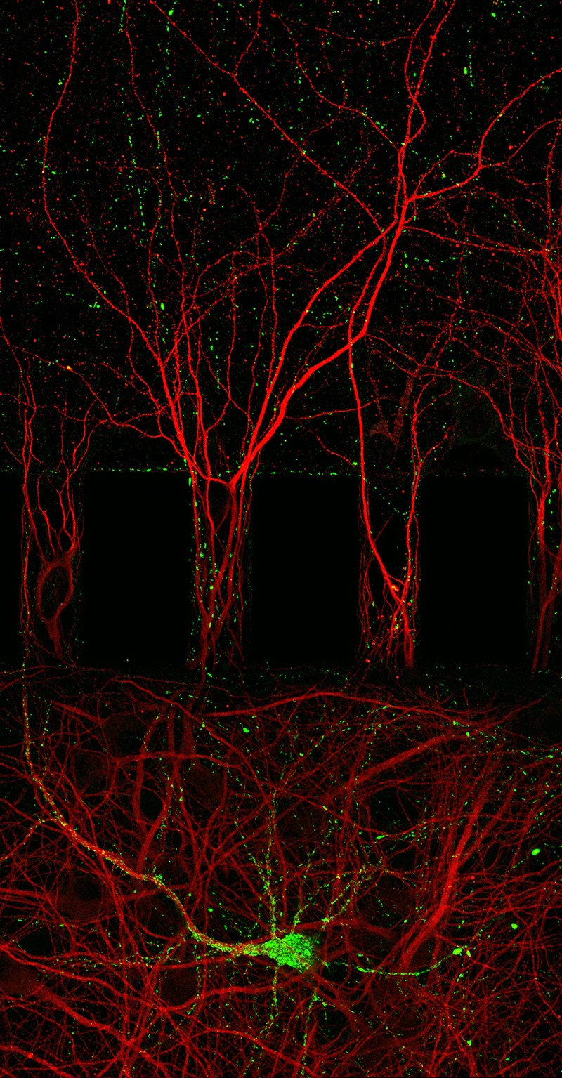
Tau Project
By: Jesse Pascual
Image from Moheb Costandi Nature 2018 Credit: Benjamin A. Lassus/Karen E. Duff/Columbia Univ. Medical Center/Servier Pharmaceuticals
Notes:
Red = MAP2, green = tau

Slide 2
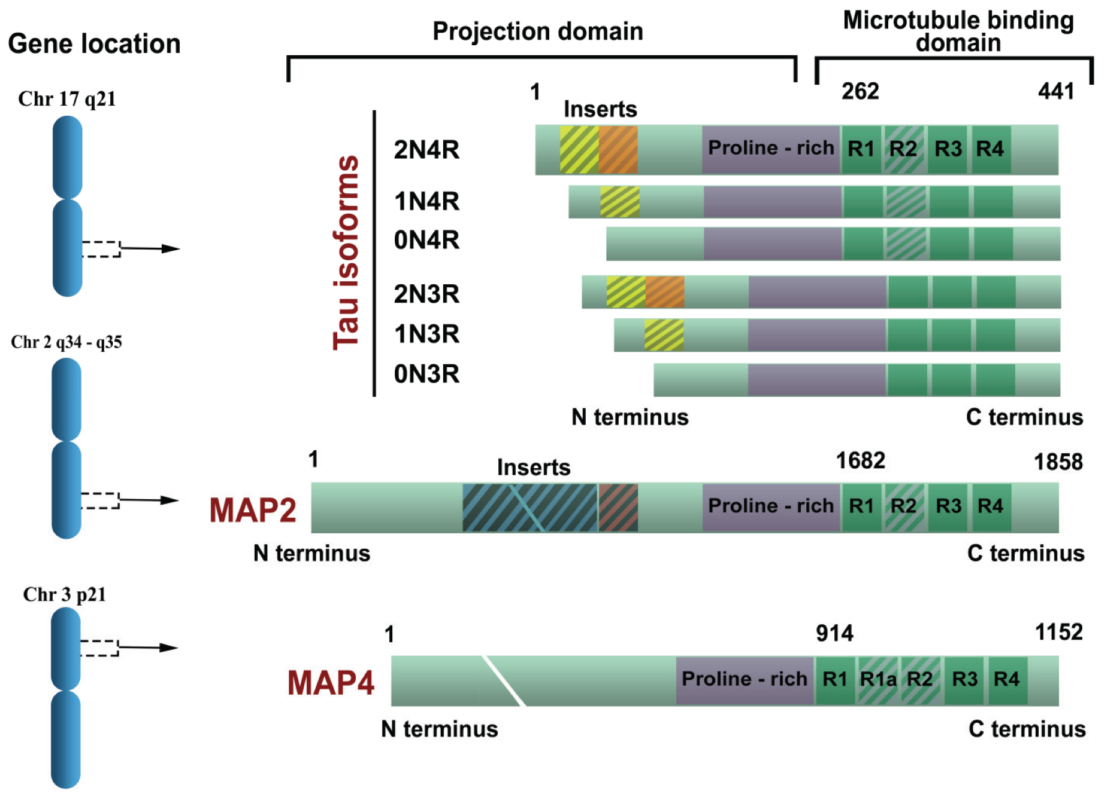

Gene Location and Protein Structure
Image from: Šimić G et al. Biomolecules 2015

Slide 3
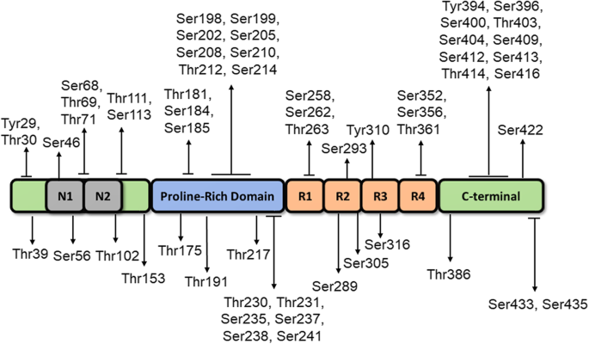
Tau Phospho-sites
_
Image from: Busche et al. 2020

Slide 4
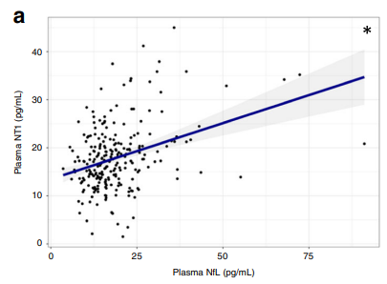
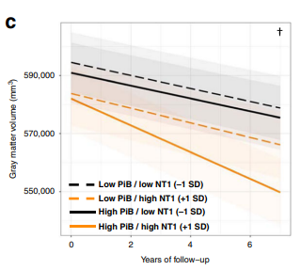
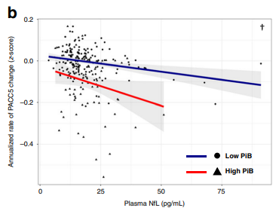

Figure 5. Plasma NfL levels correlated with plasma NT1, longitudinal cognitive decline
a) NT1 and NfL in the same plasma samples were significantly associated with each other (a; n = 236; t(230) = 4.39, p = 0.0030)
b) Greater baseline plasma NfL was associated with greater cognitive decline in individuals with high PiB PET at baseline (b; n = 236; t(1074) = −2.14, p = 0.046).
c) Greater baseline plasma NfL was associated with greater gray matter volume loss in individuals with higher baseline β-amyloid as assessed by PiB PET (c; t(290) = −2.768, p = 0.0129).
Chhatwal et al. Nature 2020
https://doi.org/10.1038/s41467-020-19543-w
Notes:
Log transformed

Slide 5
Demographics
UKY PID | UKY Case # | Age | Sex | PMI | NPDX | Region Cut
7001 | DS-1 | 67 | F | 18.02 | DSAD | Superior FCX
7007 | DS-2 | 62 | F | 1.5 | DSAD | Superior FCX
7013 | DS-3 | 57 | F | 16 | DSAD | Superior FCX
7033 | DS-4 | 52 | F | 11 | DSAD | Superior FCX
7021 | DS-5 | 59 | F | 19.52 | DSAD | Superior FCX
7082 | DS-6 | 64 | F | 6.5 | DSAD | Superior FCX
7060 | DS-7 | 49 | F | 9 | DSAD | Superior FCX
7025 | DS-9 | 51 | F | 13.21 | DSAD | Superior FCX
7062 | DS-10 | 55 | F | 3.38 | DSAD | Superior FCX
 | DSAD
N | 9
Age at death, years | 57.3 ± 6.2 (49-67)
Male/Female, n/n | 0/9
Post mortem interval (PMI), hours | 11.8

Slide 6
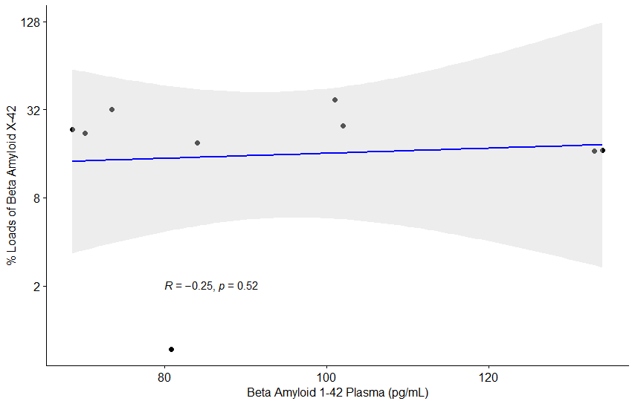
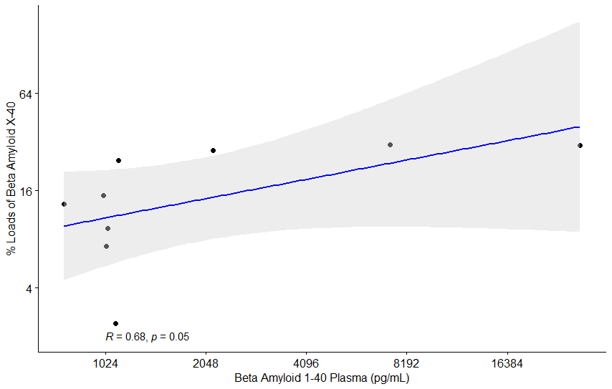
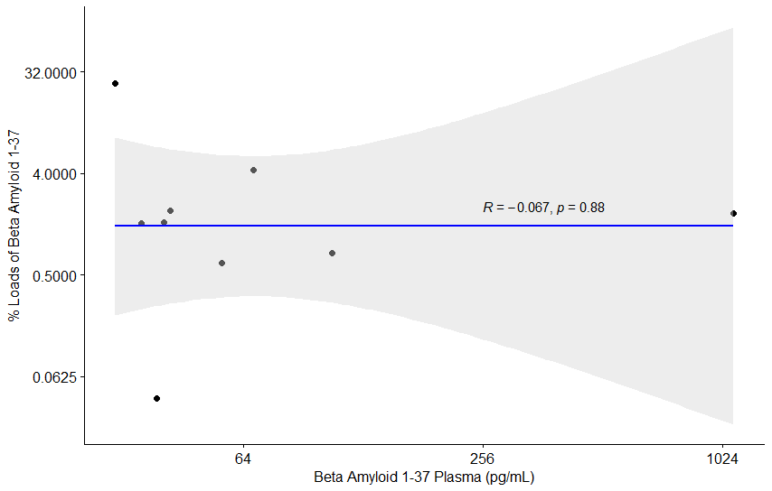
Analysis of Loads – Beta Amyloid monomers
Generated in Aperio ImageScope
Graphs generated in R

Slide 7
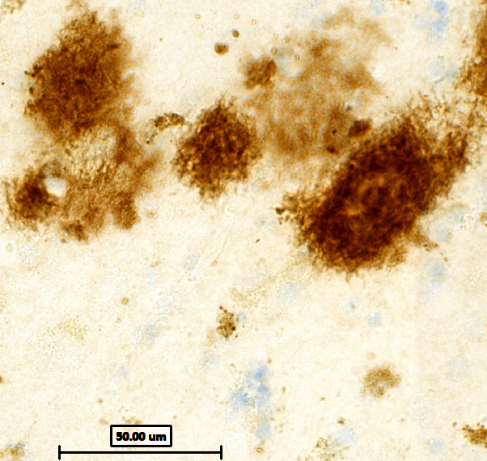
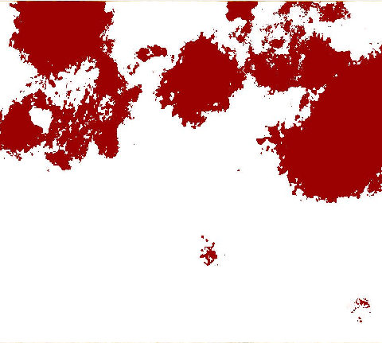
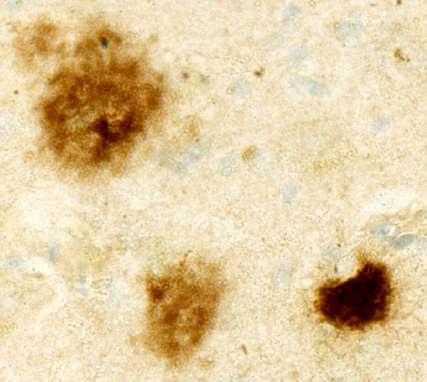

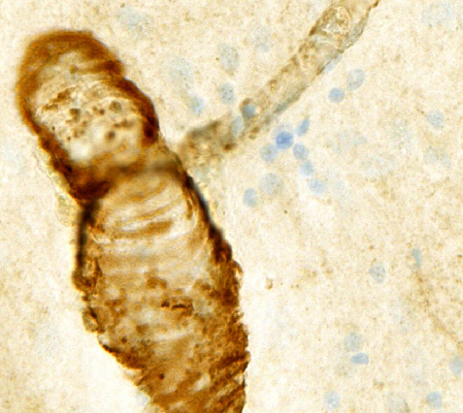
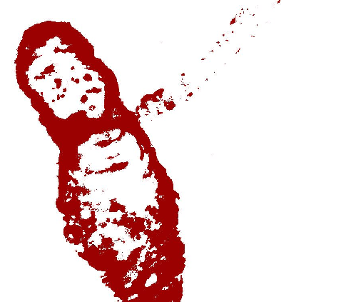
Analysis of Loads – Beta Amyloid monomers
Staining
Algorithm
Quantitation
AB42
AB40
AB37
Figure. Amyloid quantification. A) The Aβ immunostain was performed on the superior frontal gyri of all cases. B) Digital analysis of amyloid plaques per square millimeter via a modified positive pixel count algorithm. Digital analysis separated the plaques and tangles by varying degrees of intensity (1+, yellow; 2+, orange; 3+, red). C) Digital analysis was calculated as loads on the y-axis and correlated to plasma levels on the x-axis. Scale bar 50µm.
Generated in Aperio ImageScope
Graphs generated in R

Slide 8
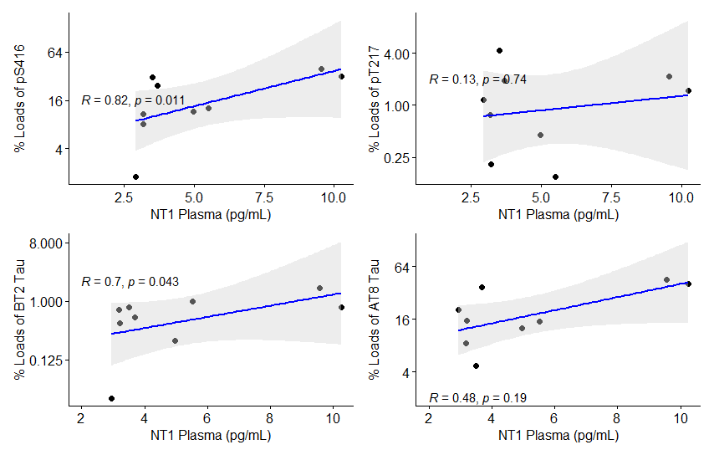
Analysis of Loads – Tau monomers
Generated in Aperio ImageScope
Graphs generated in R

Slide 9
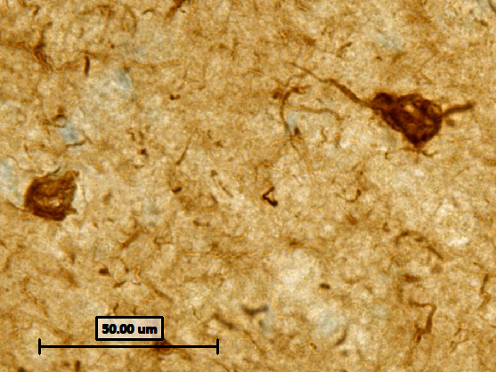
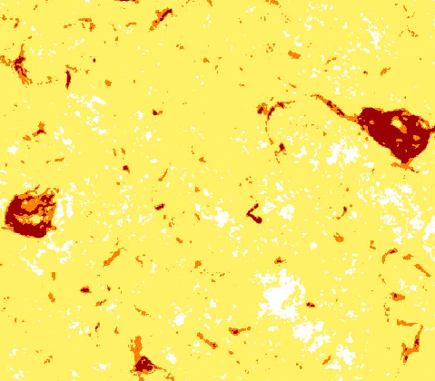
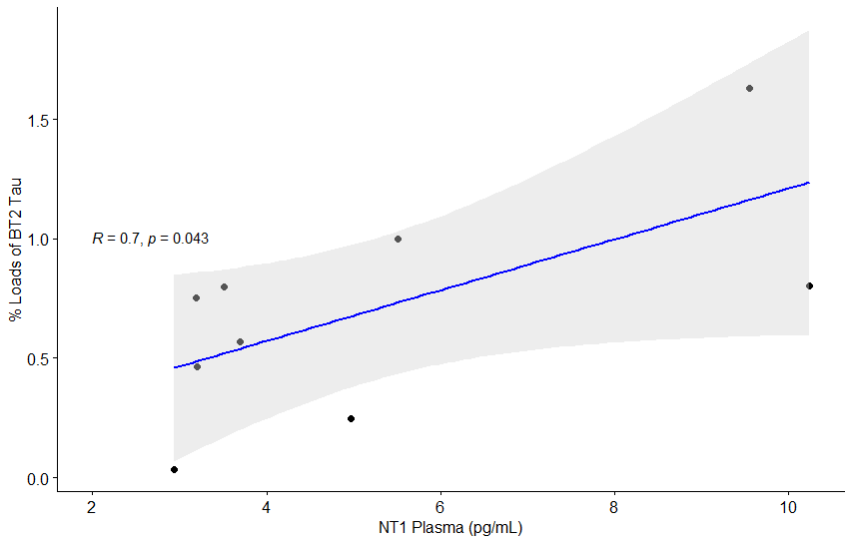
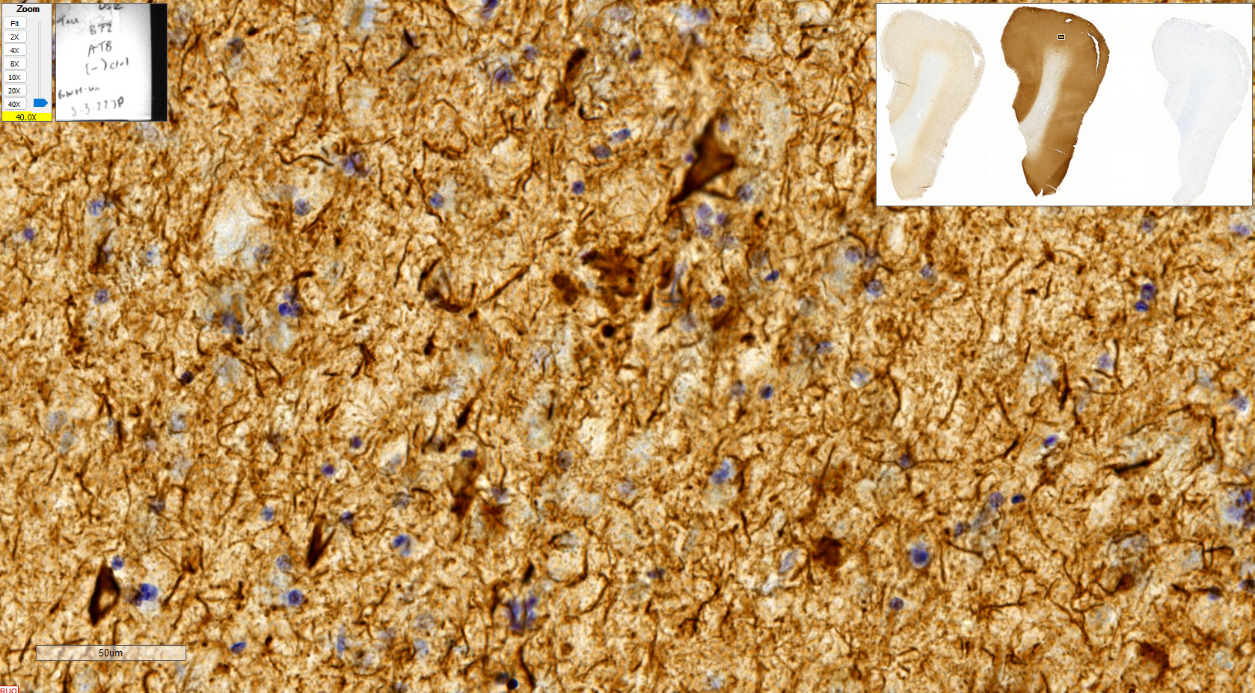
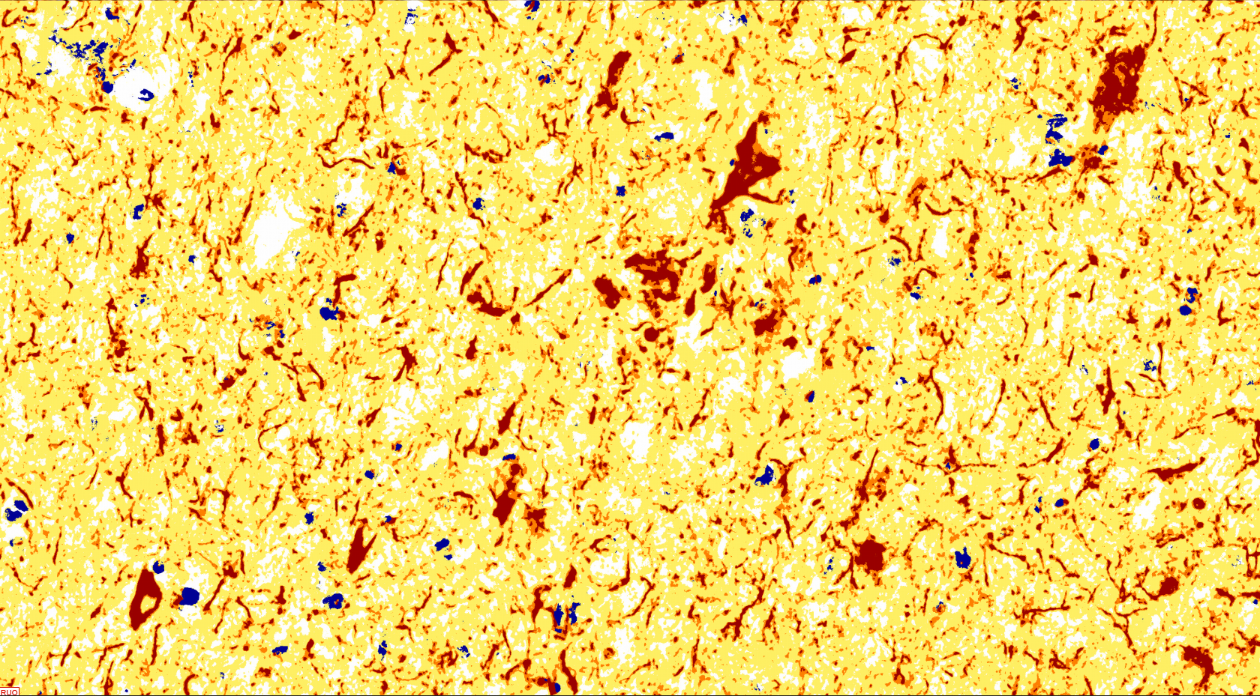
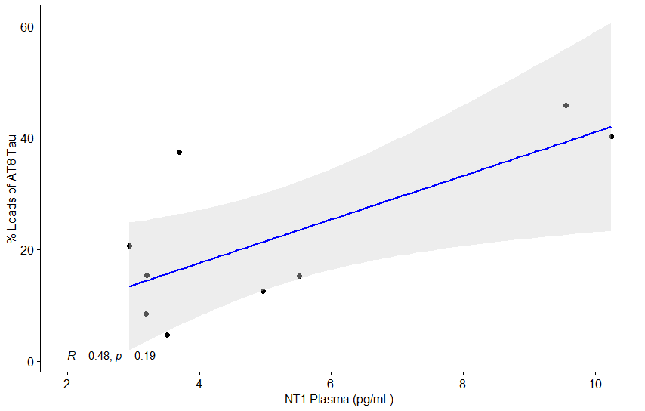
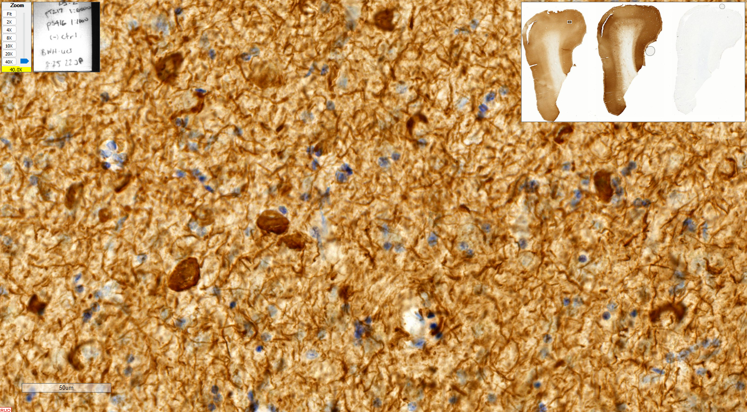
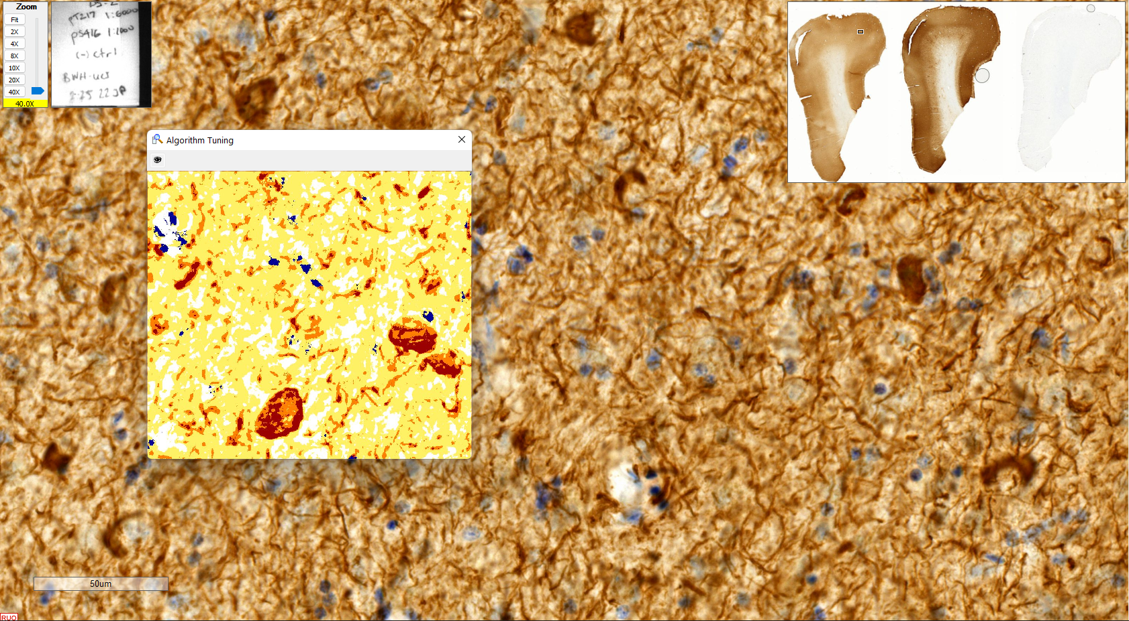
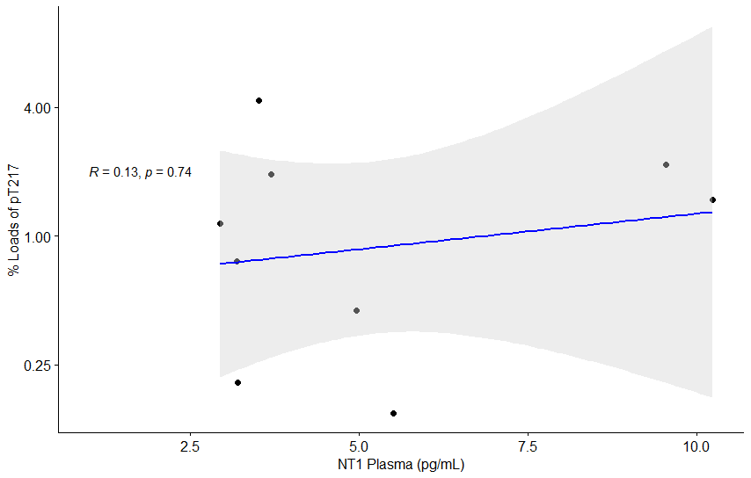
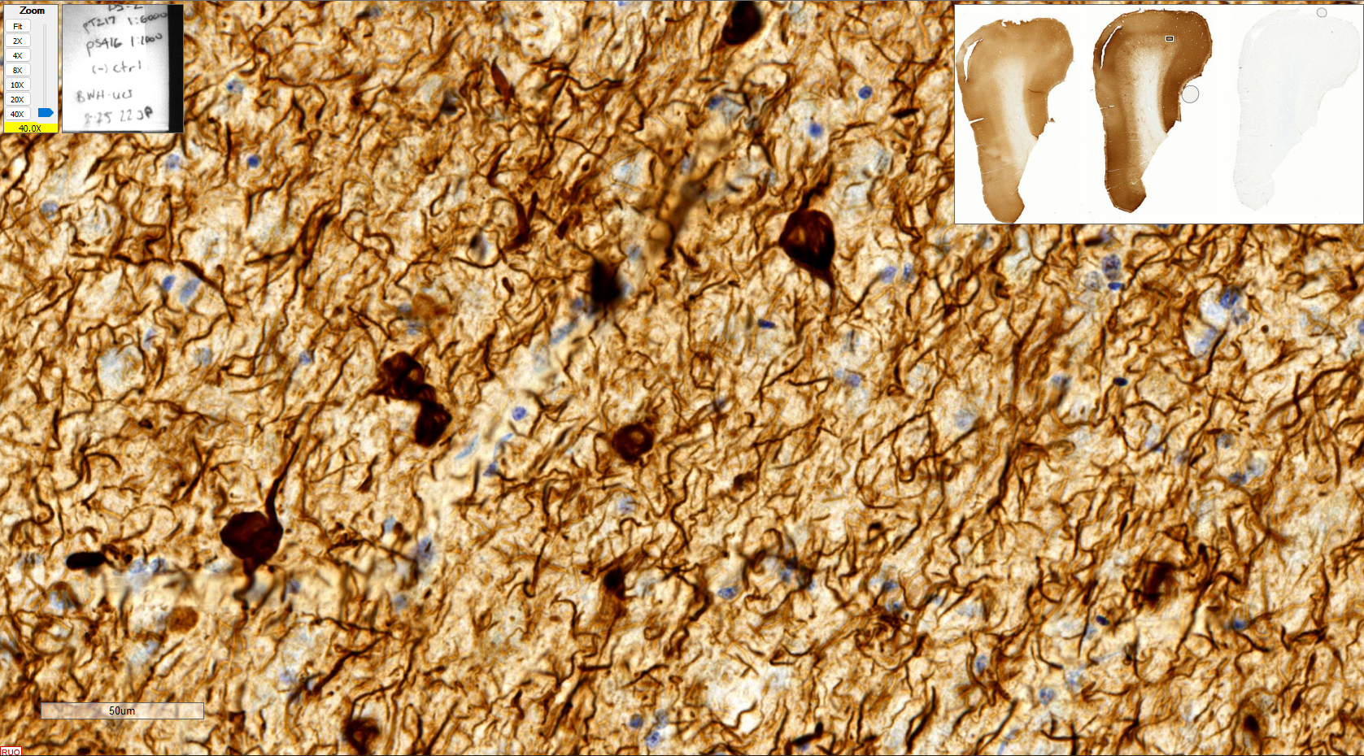
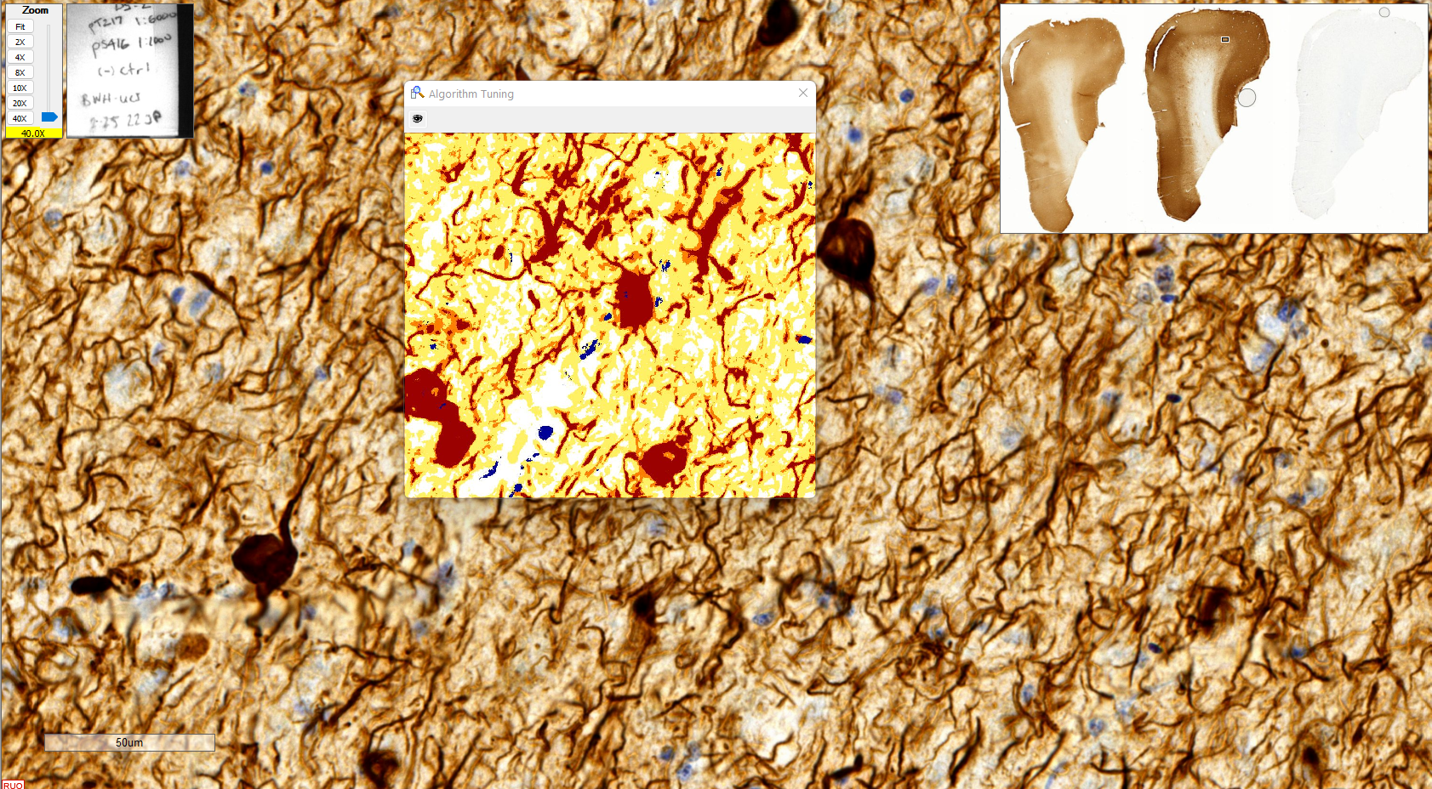
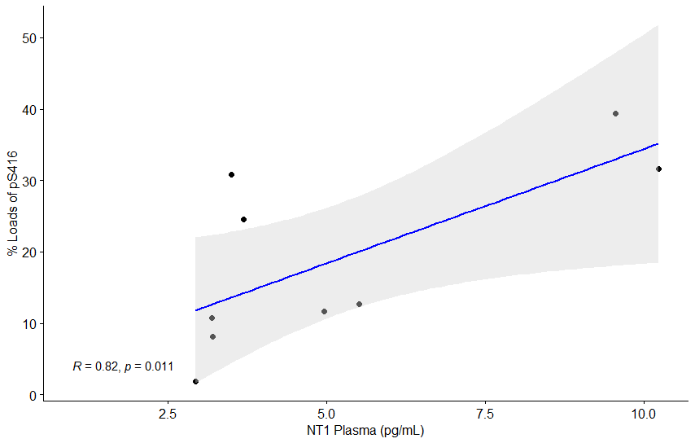
Analysis of Loads – Tau monomers
Staining
Algorithm
Quantitation
A
B
BT2
AT8
pT217
pS416
Figure. Tau quantification. A) The Tau immunostain was performed on the superior frontal gyri of all cases. B) Digital analysis of neurofibrillary tau tangles per square millimeter via a modified positive pixel count algorithm. Digital analysis separated the plaques and tangles by varying degrees of intensity (1+, yellow; 2+, orange; 3+, red). C) Digital analysis was calculated as loads on the y-axis and correlated to plasma levels on the x-axis. Scale bar 50µm.
Generated in Aperio ImageScope
Graphs generated in R

Slide 10
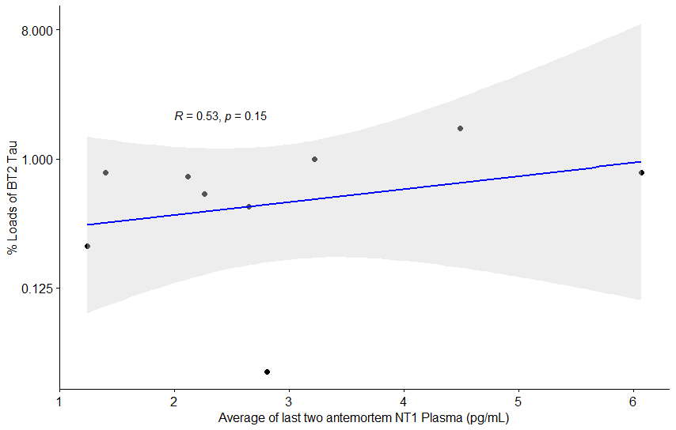
Analysis of Loads – Tau monomers for BT2 vs NT1
Generated in Aperio ImageScope
Graphs generated in R

Slide 11
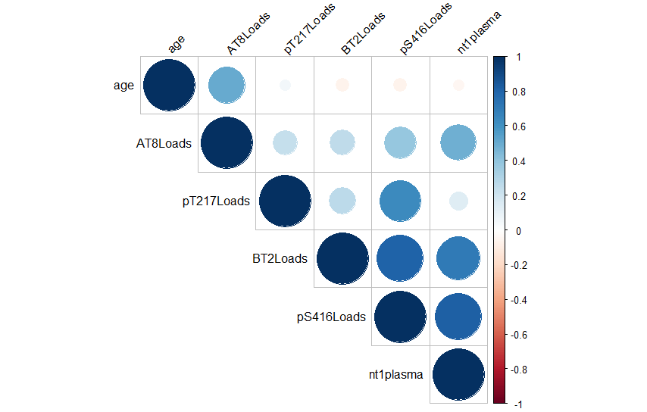
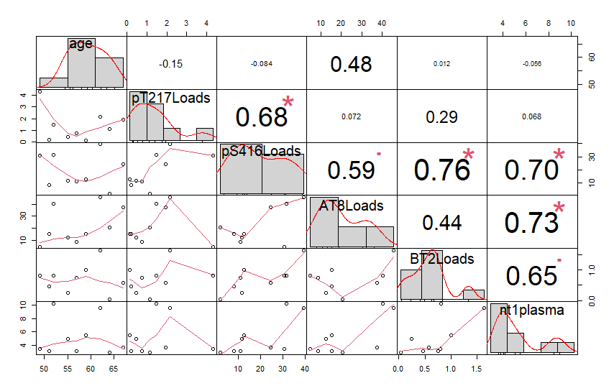
Correlation: Postmortem Loads to Antemortem Analytes
Generated in R

Slide 12
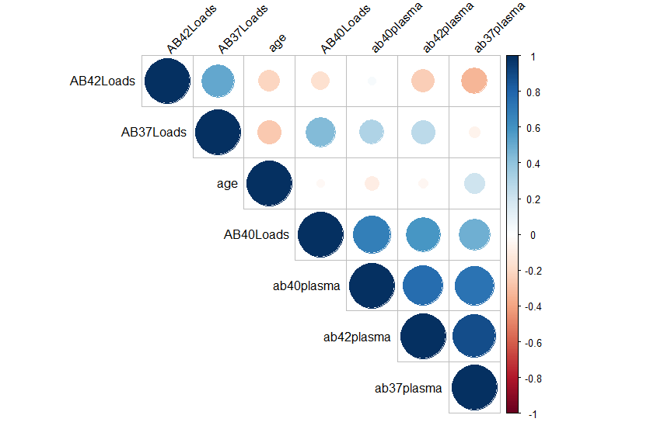
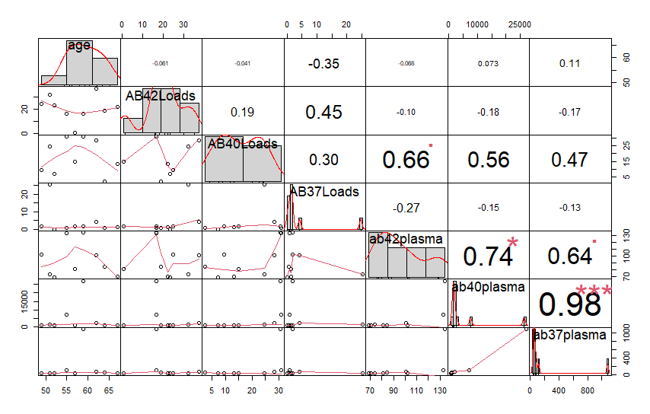
Correlation: Postmortem Loads to Antemortem Analytes
Generated in R

Slide 13
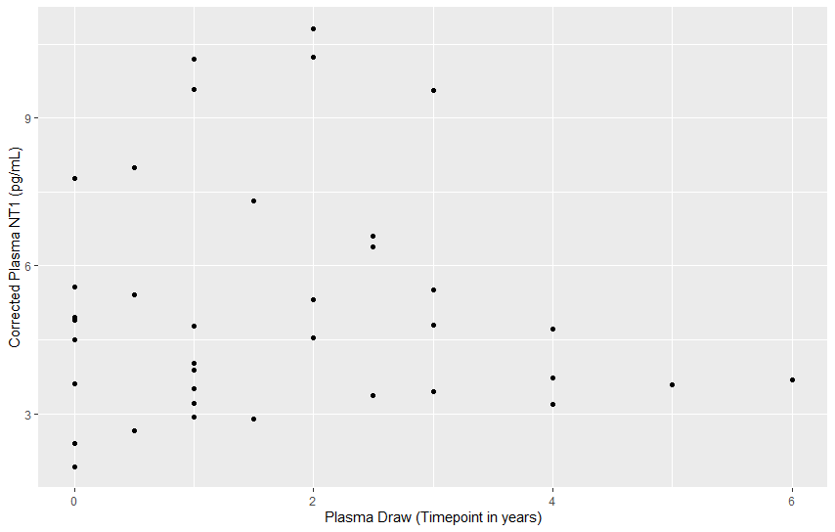
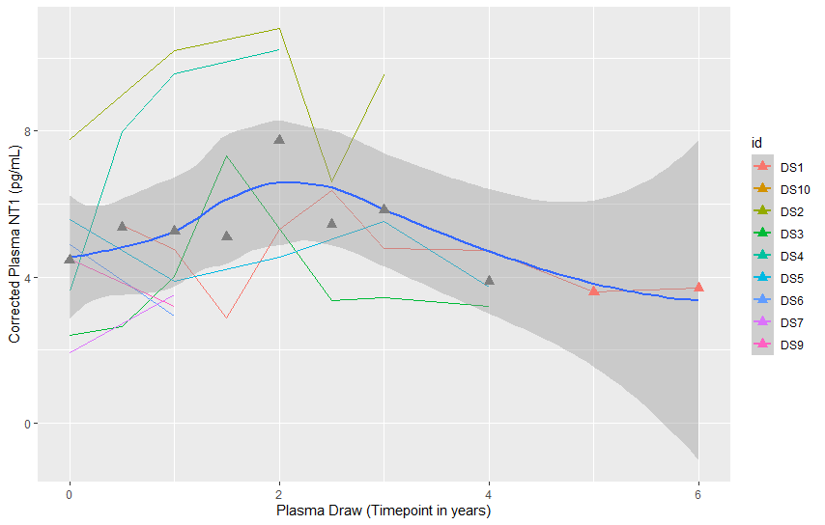
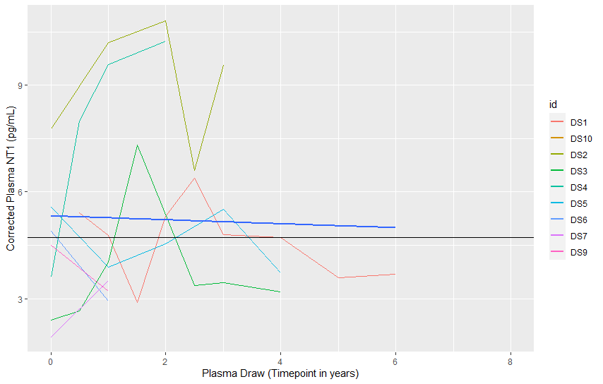
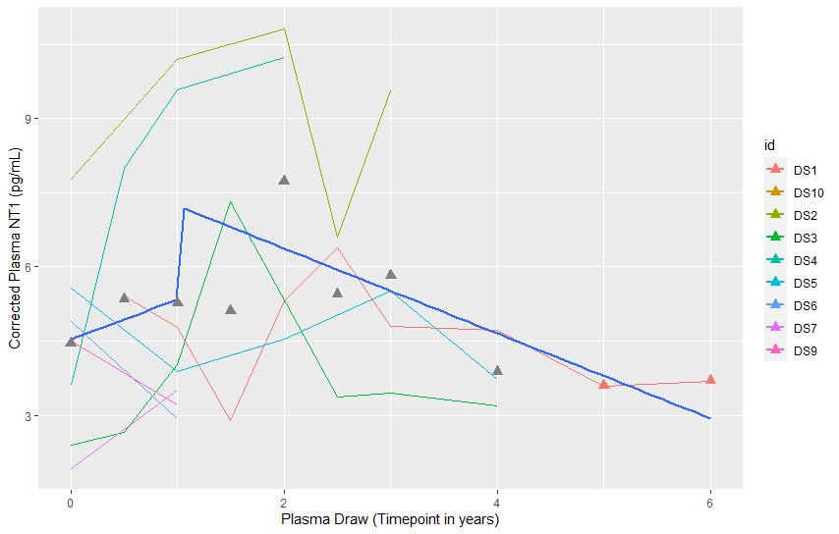
Longitudinal Analysis – Baseline to Antemortem Plasma
A
B
C
D
Generated in R

Slide 14
Longitudinal Analysis – Baseline to Antemortem Plasma
Generated in R

Slide 15
Longitudinal Analysis – Normalized
Evaluating surpassing a threshold, defined as mean.
How many times did the case pass this threshold before death?
Can this biomarker be used as predictor, if so where does it match with postmortem loads?
Generated in R

Slide 16
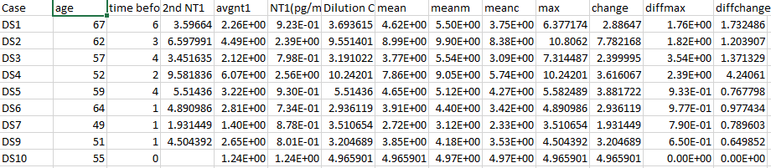
Calculations for Average of Last 2 Antemortem Analytes
Evaluated plasma NT1 tau (pg/mL) from % change trending downward before/after max NT1.
Calculated by measuring Average NT1 plasma versus the maximum level of NT1 for a given case.
outside of CI – DS3
removed: DS10, only baseline data
Giavarina D Biochem Med 2015
Bland J, Altman D Lancet 1986
Generated in R

Slide 17
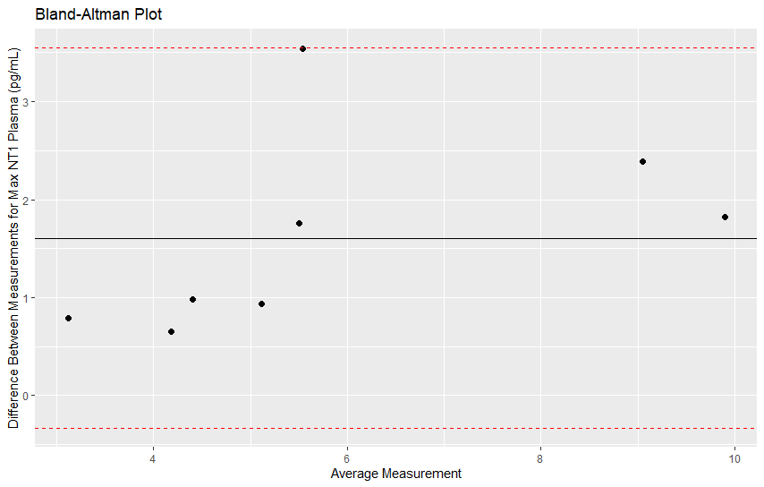
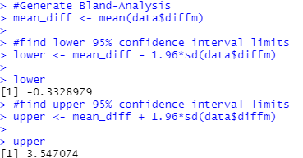
Bland-Altman Analysis – Correlation & Agreement
outside of CI – DS3
removed: DS10, only baseline data
Evaluated plasma NT1 tau (pg/mL) from % change trending downward before/after max NT1.
Calculated by measuring Average NT1 plasma versus the maximum level of NT1 for a given case.
Giavarina D Biochem Med 2015
Bland J, Altman D Lancet 1986
Generated in R

Slide 18
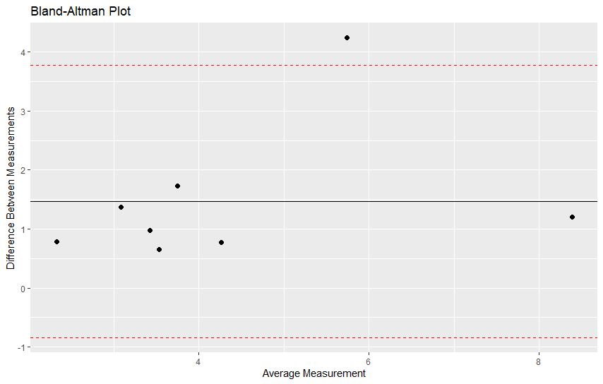
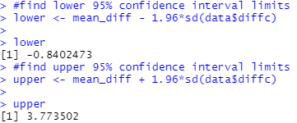
Bland-Altman Analysis – Correlation & Agreement
*outside of CI – DS4
*removed: DS10, only baseline data
Evaluated plasma NT1 tau (pg/mL) from % change trending downward before/after max NT1.
Calculated by measuring Average NT1 plasma versus the level of NT1 seeing a downward trend for a given case.
Giavarina D Biochem Med 2015
Bland J, Altman D Lancet 1986
Generated in R

Slide 19
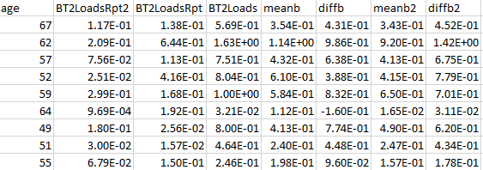
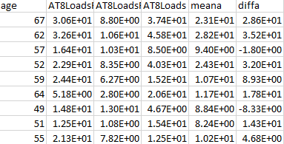
Calculations for Interbatch Analysis of IHC Loads
Giavarina D Biochem Med 2015
Bland J, Altman D Lancet 1986
Generated in R

Slide 20
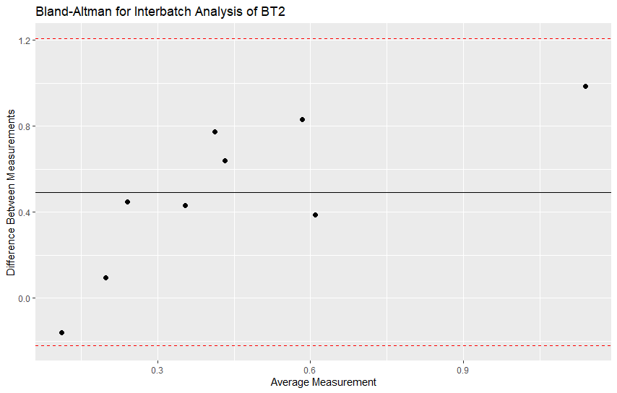
Bland-Altman Analysis – Interbatch Stains BT2
Evaluated interbatch staining variability.
Calculated by Tau BT2 from the initial load versus repeats.
Giavarina D Biochem Med 2015
Bland J, Altman D Lancet 1986
Generated in R

Slide 21
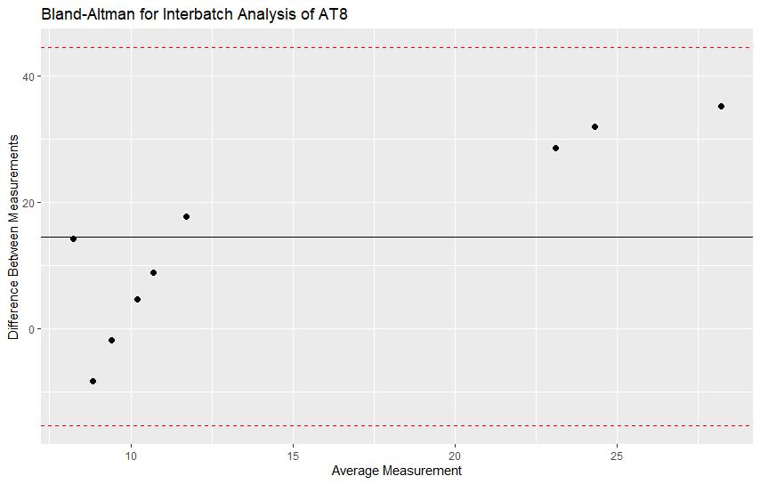
Bland-Altman Analysis – Interbatch Stains AT8
Evaluated interbatch staining variability.
Calculated by Tau AT8 from the initial load versus repeats.
Giavarina D Biochem Med 2015
Bland J, Altman D Lancet 1986
Generated in R

